Slide 1
Wednesday 3rd March
English
Learning Intentions:
4: To draft using writing similar to that which they are planning to write in order to understand and learn from its structure, vocabulary and grammar.
5 and 6: To compose and rehearsing sentences orally (including dialogue), progressively building a varied and rich vocabulary and an increasing range of sentence structures.

Slide 2

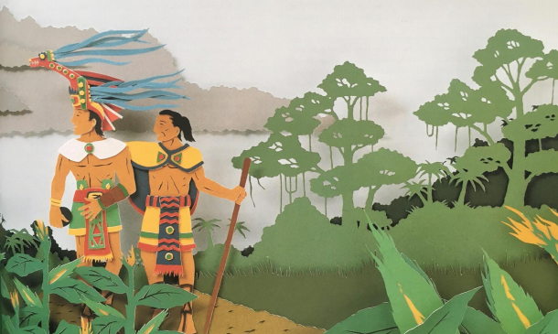
Starter:
There are many Mayan myths and legends. Often these stories have magical or supernatural themes. They are told through generations, verbally, and have been added to over time.
Often these myths/legends have a moral or a lesson for the reader.
What lesson do you think you could take from Rain Player?
*If you are at home, share your ideas on
Class Dojo.*

Slide 3
Our aim: we are building up to writing our own character descriptions of a Mayan God.
Over the weeks, we will look at different Mayan Gods and aspects of their life.
We’ll take notes and collect vocabulary on some of the Gods with a different focus each day.
Like before, there will be lessons where we collect vocabulary and super sentences.
TODAY it is time to start writing your own character description.

Slide 4
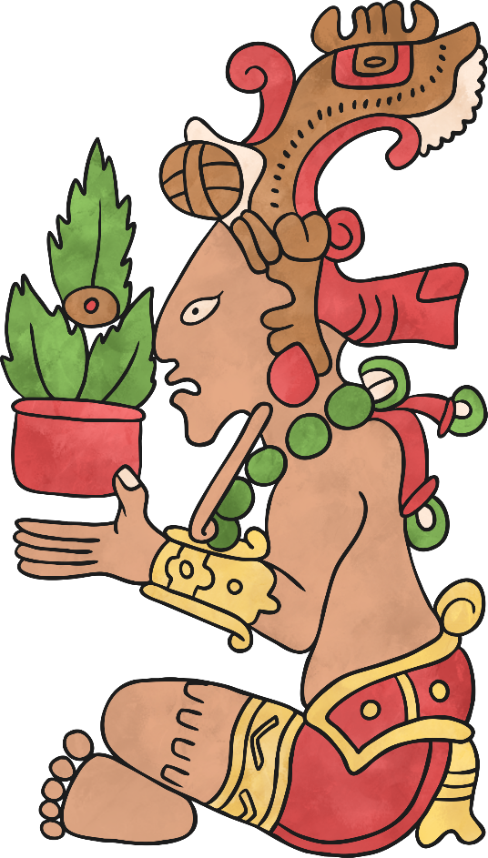
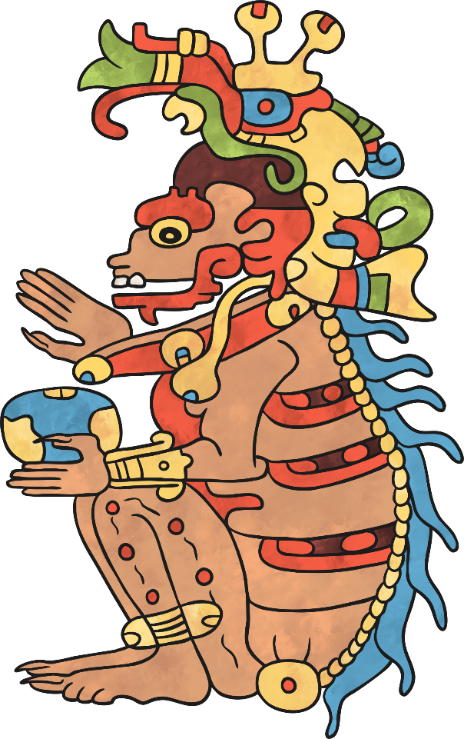
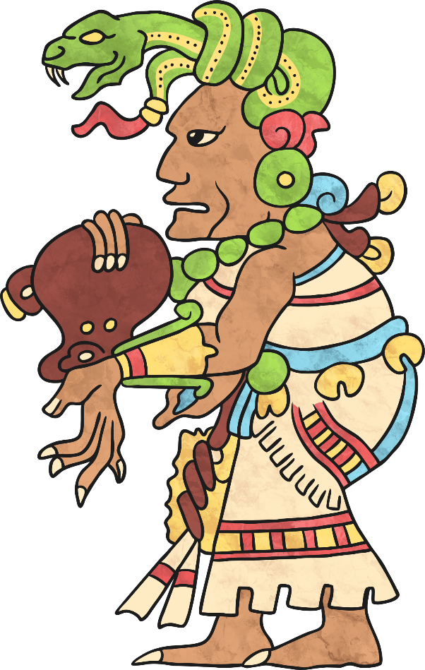
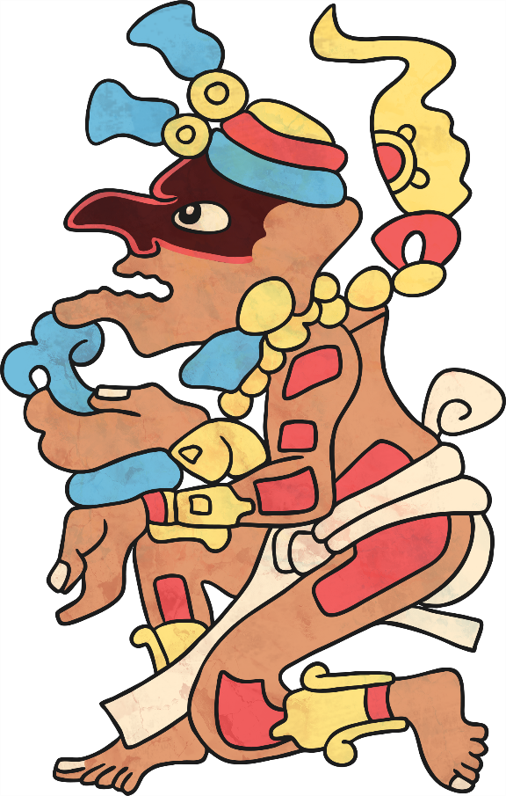
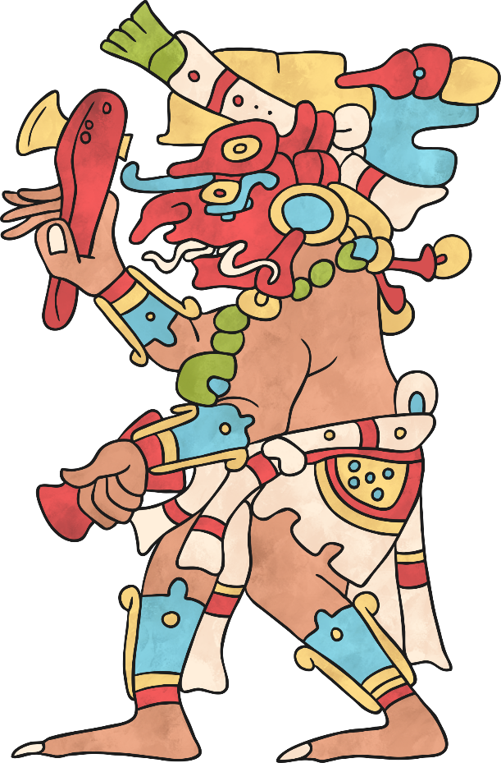
Part 1: Choosing your God/Goddess
This is your choice.
You can choose to invent your OWN God/Goddess using Mayan characteristics/themes.
OR you may pick one of the key Mayan Gods (we researched these last week).
This may be easier as you already have the facts about them.
Go back to your notes from last Tuesday and Wednesday to find their descriptions.

Slide 5
Itzamna
Ix Chel
Chac
Yumil Kaxob (God of Maize)
Kimi
K’inich Ahau

Slide 6
Part II: Using your notes
If you are going to write a character description of a traditional Mayan God or Goddess, go back to your notes from last Tuesday and Wednesday.
Make sure you know about their appearance, what/who they were God of, what they were ‘known’ for, and any special traits.
Use this time to research extra information for the answers to these questions. Websites are on the next slide.

Slide 7
Part II: Using your notes
Maya Religion, Gods, Cosmos and religious rituals (KS2) (mayaarchaeologist.co.uk)
Maya Civilization for Kids: Religion and Mythology (ducksters.com)
Mayan gods and goddesses for Kids / The Maya: history, culture & religion (the-maya.eu)
Mayan Gods For Kids | Mayan God Names | DK Find Out

Slide 8
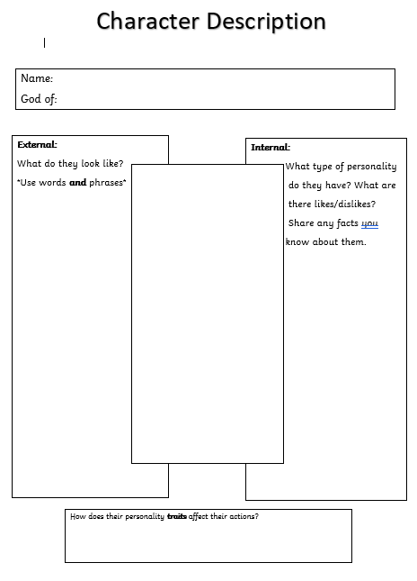
Part III: Planning your description
You can plan your description using the planning template.
This can be printed or drawn out into your book – whichever is easiest.

Slide 9
Plenary
Think of an effective opening sentence for your descriptive paragraph.
When we write up our description, we don’t want to start it with ‘my character…’ or ‘He/she was…’.
Examples:
Chac, God of Rain, was one of the most infamous, powerful Mayan Gods.
The Lord of Death, also known as ‘Kimi’, was one of the most terrifying, formidable Mayan Gods.

