Slide 1
Wednesday 10th March
English
Learning Intentions:
5: To gather information from non-fiction over a wide range of subjects identifying what the text is about, the type of text and discussing titles and subheadings.
6: identifying the audience and purpose of the writing (and structural features).
LI: To identify the audience and purpose of a text. (Context: biography).

Slide 2
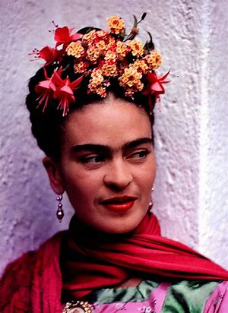
Starter
We will be writing our own biography on Frida Kahlo, the inspirational figure whom we are studying.
In 2 minutes, note down as many facts as you can think of about Frida.
Online Timer (timeanddate.com)

Slide 3
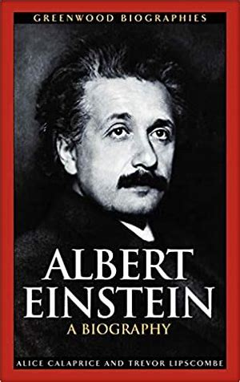
What is a biography?
A biography gives facts about a person’s life.
It is not written by the subject of the book but by an author who has done their research and knows a great deal about that person.
Biographies are written in the third person and can be written about someone who is no longer alive.
It is written in chronological order (the order in which it happened).

Slide 4
Other Important Features of a Biography
A biography is a life story written in chronological order.
It can include information about when and where the subject was born, their childhood, important events in their lives including information about what they did or achieved.
If the person is no longer alive, it may include information about when and how they died.
The biography may also include direct quotes from the subject or quotes from others about the subject.

Slide 5
Shapes for a Biography
Before we begin our sentence stacking lessons, we need to understand what a biography is made up of, and what a complete biography looks like.
To help us with that, we can use non-fiction shapes. Here are the shapes that make up a biography.
*See how many shapes you can identify the meaning of.*

Slide 6
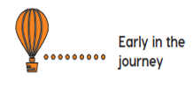
Shapes
Information about the person’s life/upbringing.
Something significant that happened towards the end of their life.
Facts/events that occurred early on in his/her life.
The moment the person reached their main goal.
An interesting, unusual fact.
Information about their death and their memory.
Main achievements/successes for this person.

Slide 7
Task 1: Structure
Piece together the biography on Frida Kahlo.
Use the vocabulary to help you. E.g. ‘finally’ would imply that this part would go near the end of the biography.
Read the sub-headings to give you clues on the chronological order of the text.
*CT to piece together the biography for the working wall.*

Slide 8
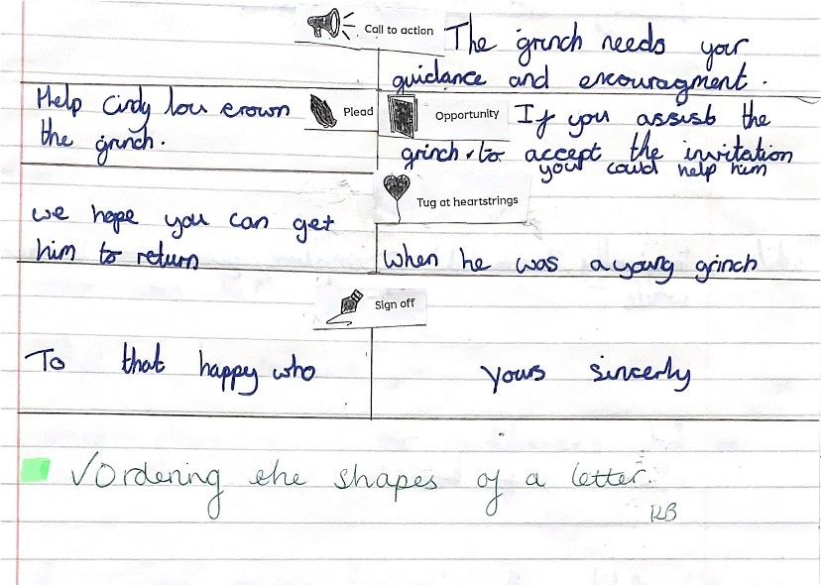
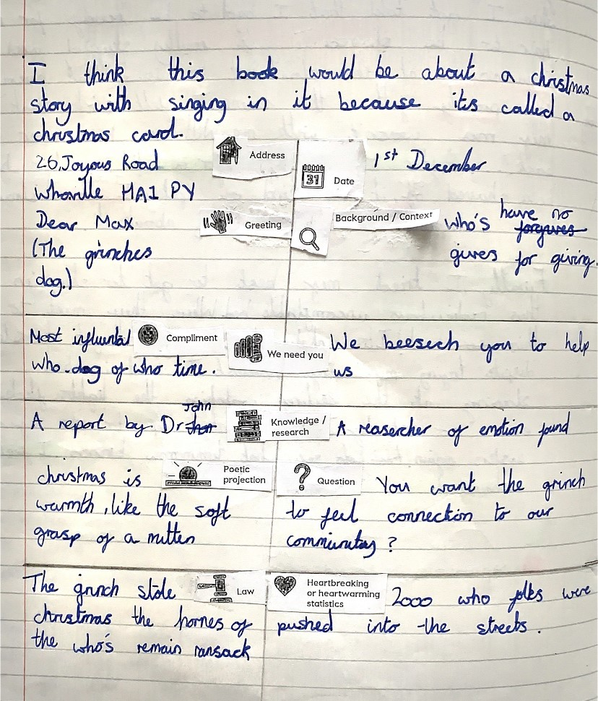
Task 2: Shapes
In your book, we are going to note down the shapes of the biography, along with an example of the shape being used in the text.
Here is an example of this from Term 2:
*CT to piece together the biography for the working wall.*

Slide 9
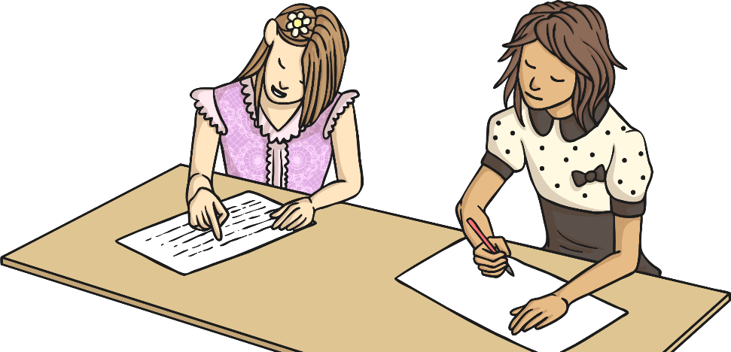
Plenary
You have 5 minutes to tell your partner as much information about yourself as possible to enable them to write a short biography of your life so far. Try to give the information in chronological order. You might want to make some quick notes.
Points to mention:
Where and when you were born
Your family
Significant events in your life and feelings about these events (e.g. starting school, joining clubs, moving house, achievements etc.)

